Slide 1

VIVEKANAND COLLEGE FOR
ADVANCED COMPUTER AND INFORMATION SCIENCE
SURAT
VEER NARMAD SOUTH GUJARAT UNIVERSITY, SURAT
PROJECT REPORT ON
FIT-BUDDY GYM
AS A PARTIAL REQUIREMENT FOR THE DEGREE
OF
BACHELOR OF COMPUTER APPLICATION
(B.C.A)2024-2025
GUIDED BY : SUBMITTED BY :
Prof. SUMATHI SHENOY AYUSH PARMAR

Slide 2
INDEX
SR NO. | DESCRIPTION
1. | Introduction
 | 1.1 Project Profile
 | 1.2 Project Introduction
2. | Environment Description
 | 2.1 Hardware Requirement
 | 2.2 Software Requirement
3. | Proposed System
 | 3.1 Scope
 | 3.2 Aim & Objective
4. | System Model Architecture
 | 4.1 Use-Case Diagram
5. | System Layout
 | 5.1 Table-Structure
 | 5.2 Screen-Layout

Slide 3
PROJECT PROFILE
Project title : Fit-buddy
Project Definition : Our vision to empowering fitness and wellness, anywhere, anytime. Transforming lives through health and wellness.
Name Of Institute : Vivekanand college for BCA
Front-end-tool : HTML, CSS, Javascript, bootstrap
Back-end-tool : PHP, MYSQL
Project guide : Prof. Sumathi Shenoy
Submitted by : Ayush Parmar
Submitted to: Vivekanand college for BCA

Slide 4
PROJECT INTRODUCTION
A gym website's primary objects include several key sections and features. The main sections comprise Home/Welcome, About Us, Services, Facilities, Membership, Classes/Schedule, Trainers/Staff, Contact/Location, and Testimonials. These sections provide essential information about the gym, its services, and facilities.
Key features of a gym website include membership registration and payment gateway, class scheduling and booking system, personal training session booking, member login and profile management, news/blog section, social media integration, photo and video gallery, online support/chat system, and search engine optimization (SEO).
Functionally, a gym website should allow users to register and log in, manage memberships (renewal, cancellation), process payments, schedule classes and receive reminders, receive email notifications, book online appointments, integrate with fitness tracking software, and provide mobile responsiveness.
In terms of content, a gym website should include gym policies and rules, membership terms and conditions, service descriptions and pricing, trainer bios and certifications, class descriptions and schedules, testimonials and success stories, fitness tips and articles, promotions and discounts, and an event calendar.

Slide 5
HARDWARE REQUIREMENT
Client Side
• Internet enable device with any browser that support bootstrap & JavaScript.
Server Side
Desktop or Laptop Computers
Input Devices
Networking Equipment
Backup Storage
Developer Side
RAM : 8 GB or above
Processor : Quad Core(Or Higer) CPU @ 2.00GHz 2.60 GHz

Slide 6
SOFTWARE REQUIREMENT
Client Side
• Client on internet : Chrome or any browser
Server Side
Payment Gateway
Send Email
Developer Side
Development IDE : Visual Studio Code
Operating System : Windows 11(64 bit)
Front-End Language : HTML, CSS, JAVASCRIPT, BOOTSTRAP
Back-End Language : PHP

Slide 7
Server : Apache Server, XAMPP
Database : MYSQL
Network Interface : 10 mbps Internet

Slide 8
Scope
Admin
Guest
Customer
PROJECT SCOPE

Slide 9
Admin
Membership and buying Management: Administer memberships, Trainer, Accessibility of gym, Allocate operations.
Product and buying Management: Products details and buy process.
Content Management: Update website content like news, events, and gym info.
Data Analytics: Members, Products data, and Gym performance reports.
User and Permission Management: Manage roles, permissions, and user accounts (e.g., admin, staff, etc.).
Security and Compliance: Ensure safety regulations, and data security are followed.

Slide 10
Guest
Browse Attractions: View gym attractions, memberships, and products and classes without an account.
Gym Information: Access basic info like trainer, timing, products, and FAQs.
Membership Pricing: See available memberships options but need to log in or register for buying.
Visitor Guidelines: Access safety regulations, gym rules, and visitor services.

Slide 11
Customer
Membership Buying: Browse membership options and buy membership online.
Product Buying: Browse product options and buy products online.
User Profile Management: Manage personal details, ticket history, and saved preferences.
Memberships: Access benefits, points, and exclusive offers.
Contact and Support: Access customer service for assistance and inquiries.

Slide 12
Aim & Objective
To provide an online platform for gym enthusiasts to access fitness resources, connect with the trainers, and achieve their wellness goals.
Provide easy access to gym information, schedules, and services.
Offer online fitness programs, workout plans, and nutrition guidance.
Facilitate membership sign-ups, bookings, and payments.
Foster a supportive community through forums, blogs, and social media.
Showcase gym facilities, equipment, and amenities.

Slide 13
Use Case Diagram
Guest
Customer
Admin

Slide 14
Use Case Diagram (Guest)
Membership Details
Gym Info
Product Details
Classes Details

Slide 15
Use Case Diagram (Customer)
Registration
Login
Membership Details
Membership Buy
Product Details
Product Buy

Slide 16
Use Case Diagram (Admin)
System Login
Manage
Customer Data
Membership Data
Membership Buyers
Product Data
Product Buyers

Slide 17
Activity Diagram
Login Activity
Registration Activity
Manage Membership Activity
Manage Product Activity

Slide 18
Login Activity
Enter Username
Enter Password
Invalid Details
[Invalid]
[Valid]
Successful Login

Slide 19
Registration Activity
Enter User Details
Invalid Details
[Invalid]
[Valid]
Registration Successful

Slide 20
Manage Membership Activity
Manage Membership
Enter Details
Enter Details
Enter Details
View Memberships
Invalid Details
Invalid Details
Invalid Details
[Invalid]
[Invalid]
[Invalid]
[Valid]
[Valid]
[Valid]
Membership Added Successfully
Membership Added Successfully
Membership Added Successfully

Slide 21
Manage Product Activity
Manage Product
Enter Details
Enter Details
Enter Details
View Products
Invalid Details
Invalid Details
Invalid Details
[Invalid]
[Invalid]
[Invalid]
[Valid]
[Valid]
[Valid]
Product Added Successfully
Product Added Successfully
Product Added Successfully

Slide 22
Table Structure
Customer table
Admin table
Membership table
Product table
Buy table
Product buy table

Slide 23
Customer
Name of the field | Name in field | Variable in php | Field name in database | Variable store in DB | Type in Field | Data type in Database
Id | txtid | $id | id | $id | Number | Int(3)
Name | txtname | $name | name | $name | Text | Varchar(20)
Gender | gen | $gender | gender | $gender | Radio Button | Text
Age | txtage | $age | age | $age | Number | Int(3)
Mobile Number | txtmobile | $mobile | mobile | $mobile | Number | Varchar(10)
E-mail | txtemail | $email | email | $email | Email | Varchar(20)
Password | txtpassword | $password $soltedpassword | password | $soltedpassword | Text | Varchar(11)

Slide 24
Admin
Field name in database | Data type in Database
id | Int(3)
name | Varchar(20)
gender | Text
age | Int(3)
mobile | Varchar(10)
email | Varchar(20)
password | Varchar(11)

Slide 25
Membership
Name of the Field | Name in Field | Variable in php | Field name in database | Variable store in DB | Type in Field | Data type in Database
Package Id | txtpid | $pid | pid | $pid | number | Int(3)
Amount | txtamount | $amount | amount | $amount | number | Int(5)
Days | txtdays | $days | days | $days | number | Int(4)
Personal Trainer | txttrainer | $trainer | trainer | $trainer | Radio button | tinyint(1)
Access | txtaccess | $access | access | $access | Radio button | tinyint(1)
Personal Locker | txtlocker | $locker | locker | $locker | Radio button | tinyint(1)
Cardio | txtcardio | $cardio | cardio | $cardio | Radio button | tinyint(1)
Steam | txtsteam | $steam | steam | $steam | Radio button | tinyint(1)

Slide 26
Product
Name of the Field | Name in Field | Variable in php | Field name in database | Variable store in DB | Type in Field | Data type in Database
Product Id | txtpid | $pid | pid | $pid | number | Int(3)
Name | txtname | $name | pname | $name | text | Varchar(20)
Price | txtprice | $price | price | $price | number | Int(5)
Image Name | txtimg | $img | img | $img | text | Varchar(20)

Slide 27
Buy
Field name in database | Datatype in database
payid(payment id) | int(3)
id(customer id) | int(3)
name(customer name) | varchar(20)
mobile | int(10)
pid(membership id ) | int(3)

Slide 28
Product_Buy
Field name in database | Datatype in database
payid(payment id) | int(3)
id(customer id) | int(3)
name(customer name) | varchar(20)
pid(product id) | int(3)
qty | int(3)
price | int(5)
total | int(10)

Slide 29
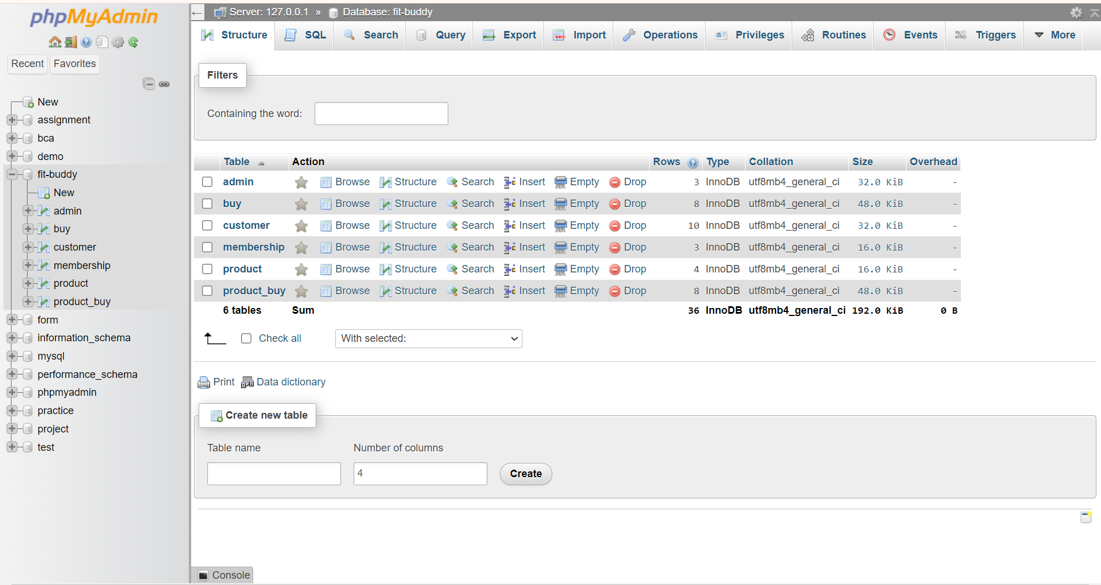
Screen Layouts
Admin MYSQL Server

Slide 30
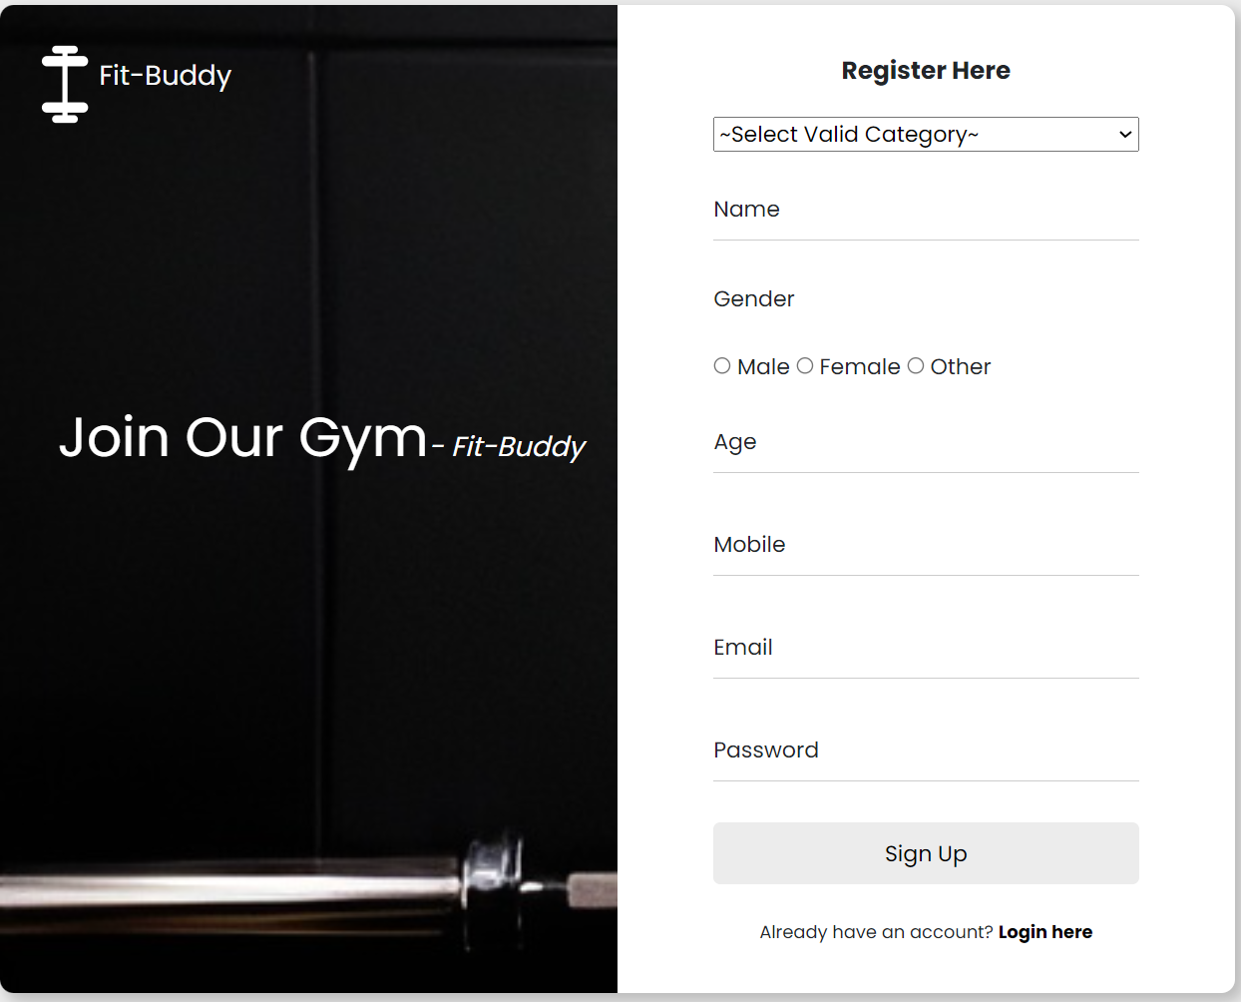
Client Side Layout
Registration Page

Slide 31
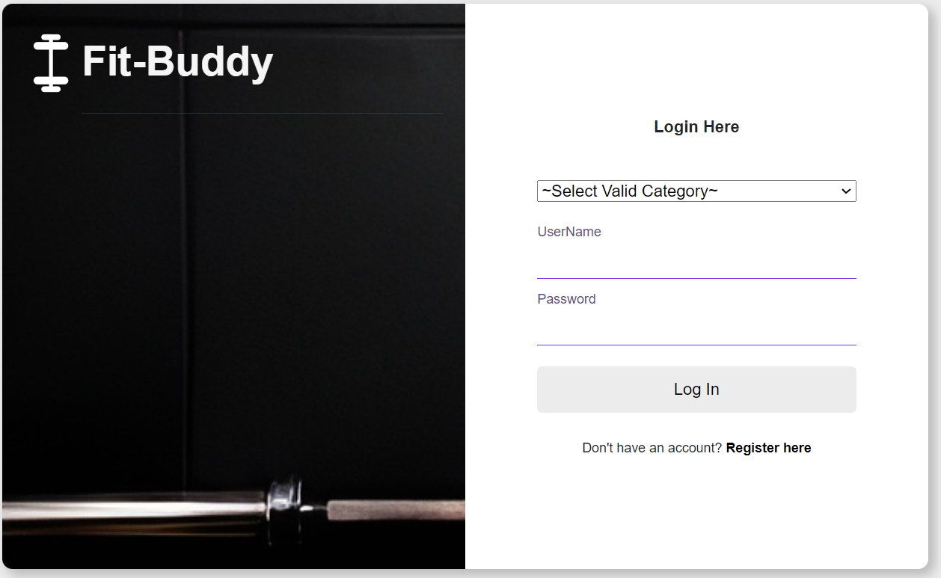
Login Page

Slide 32
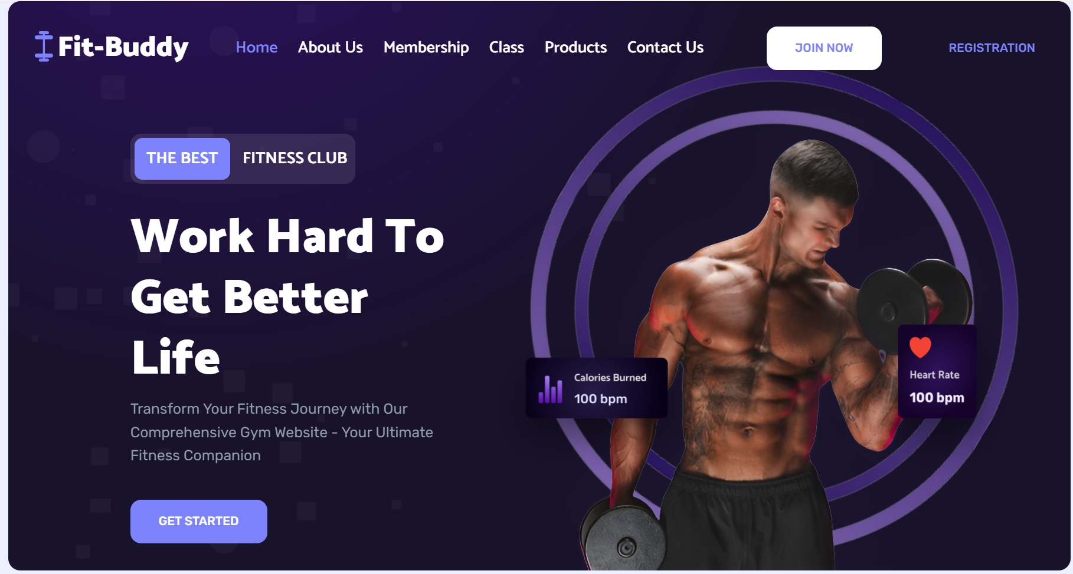
Home Page

Slide 33

About Us Page

Slide 34
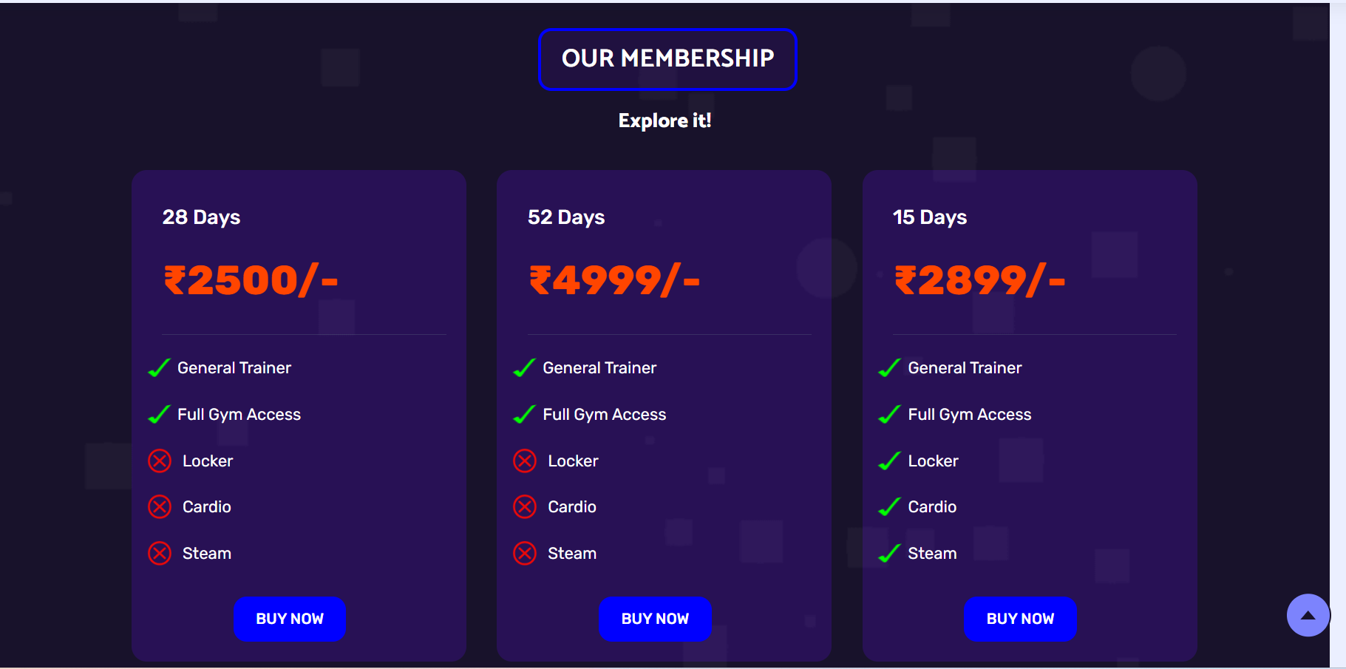
Memberships Page

Slide 35
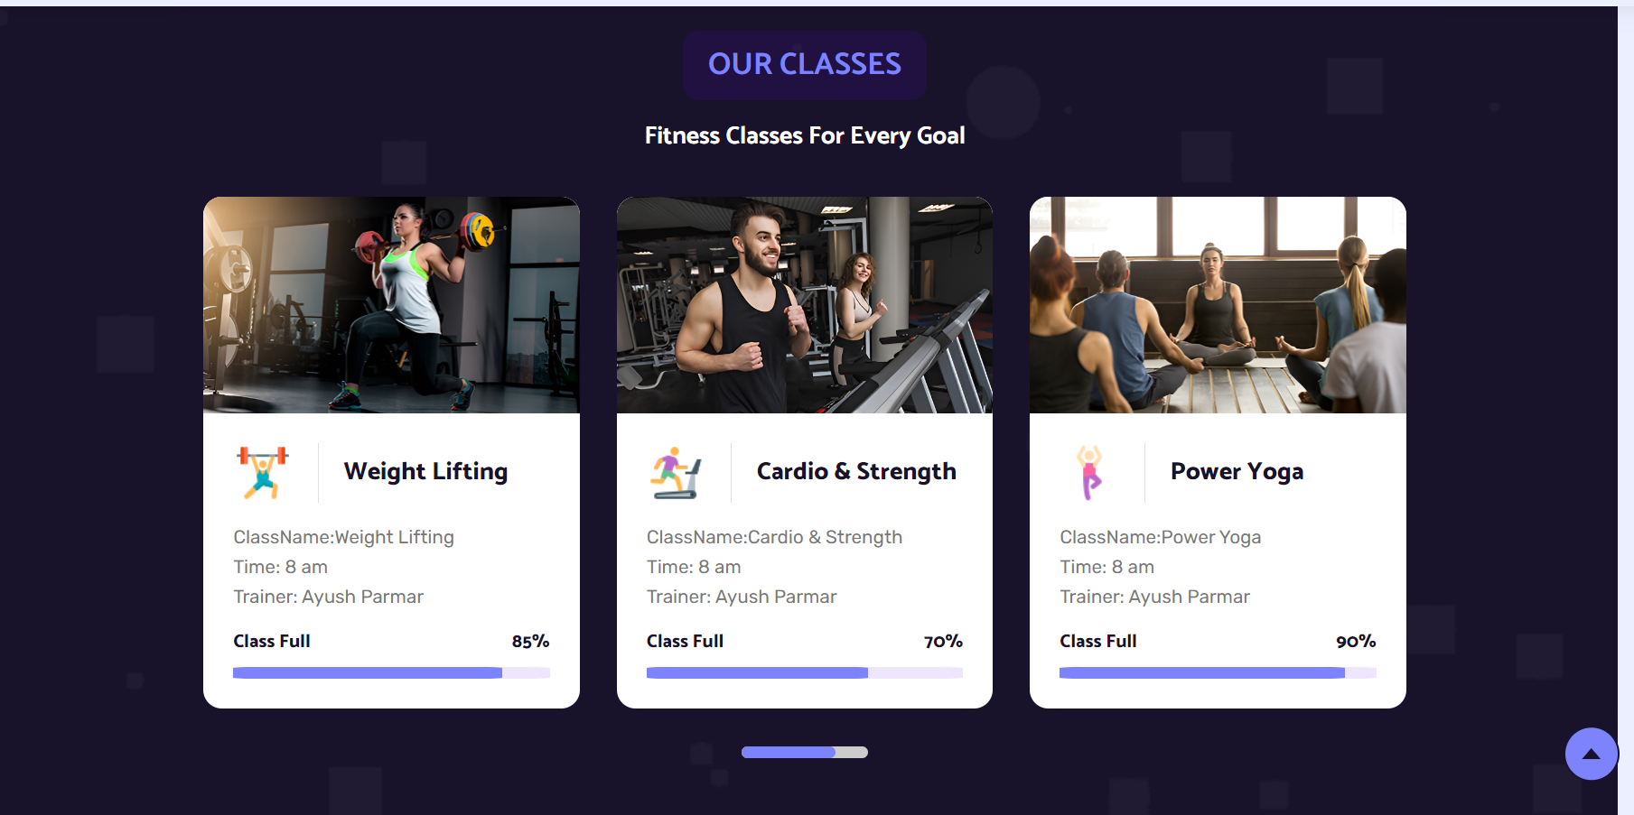
Classes Page

Slide 36
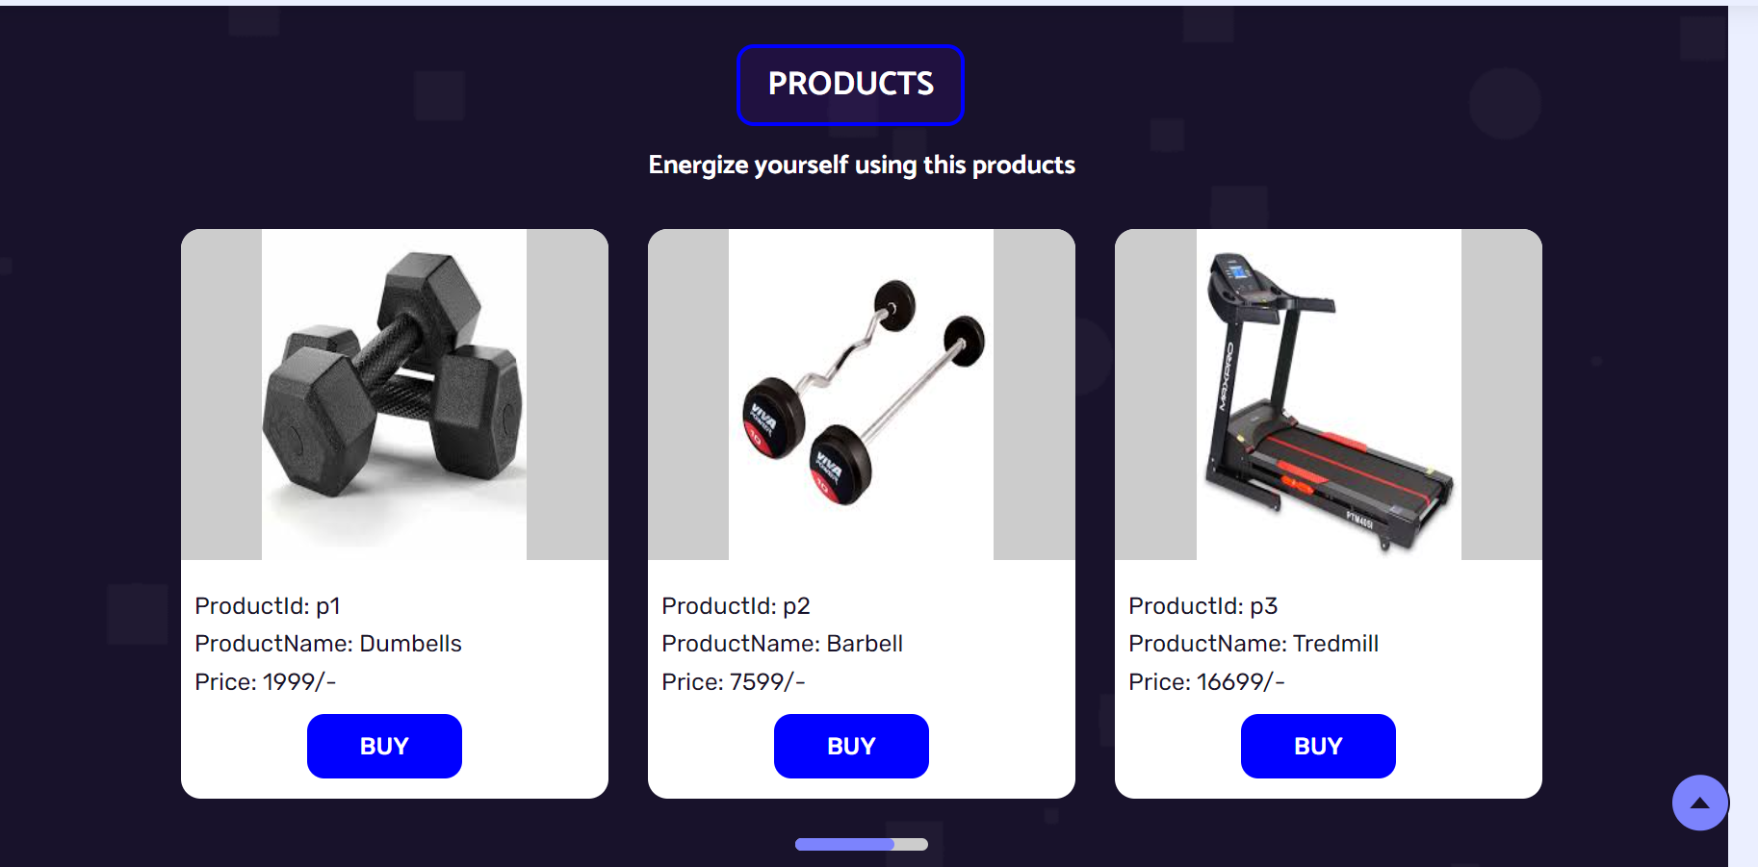
Products Page

Slide 37
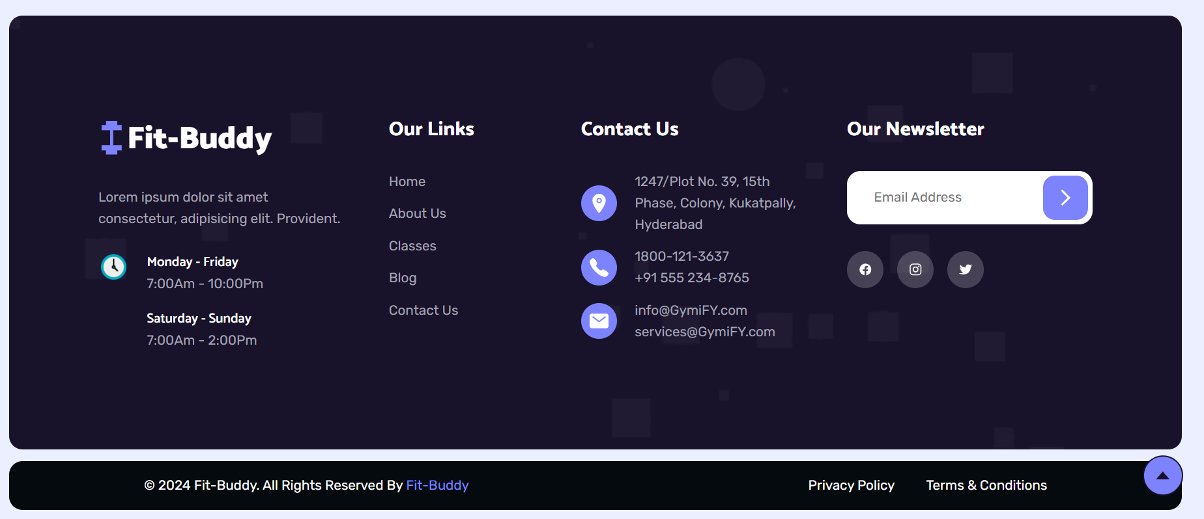
Contact Us Page

Slide 38
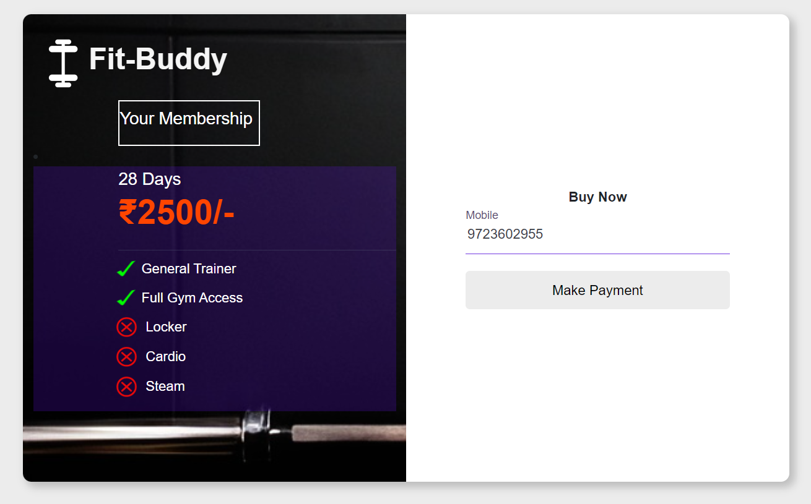
Membership Buy Page

Slide 39
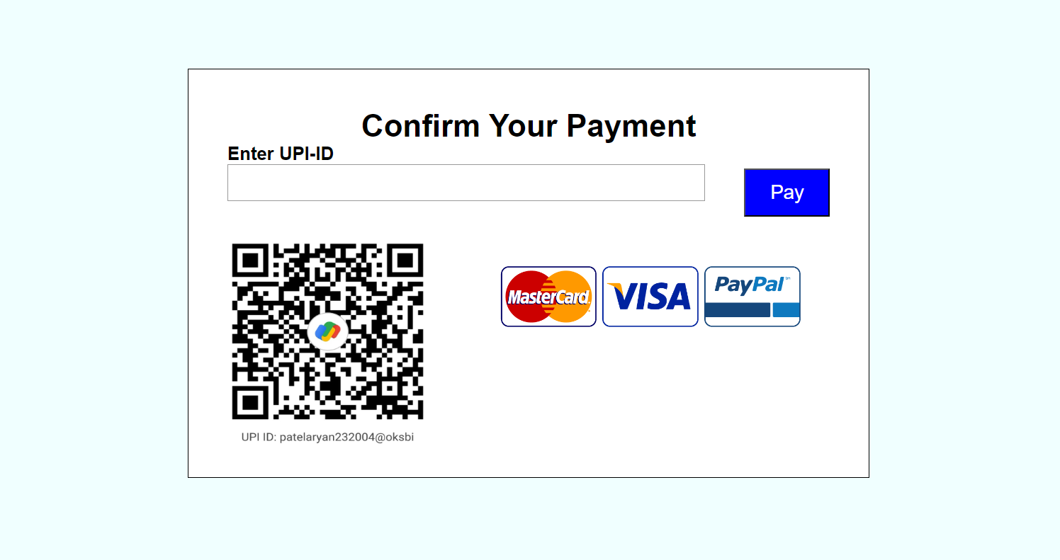
Payment Page Of Membership

Slide 40
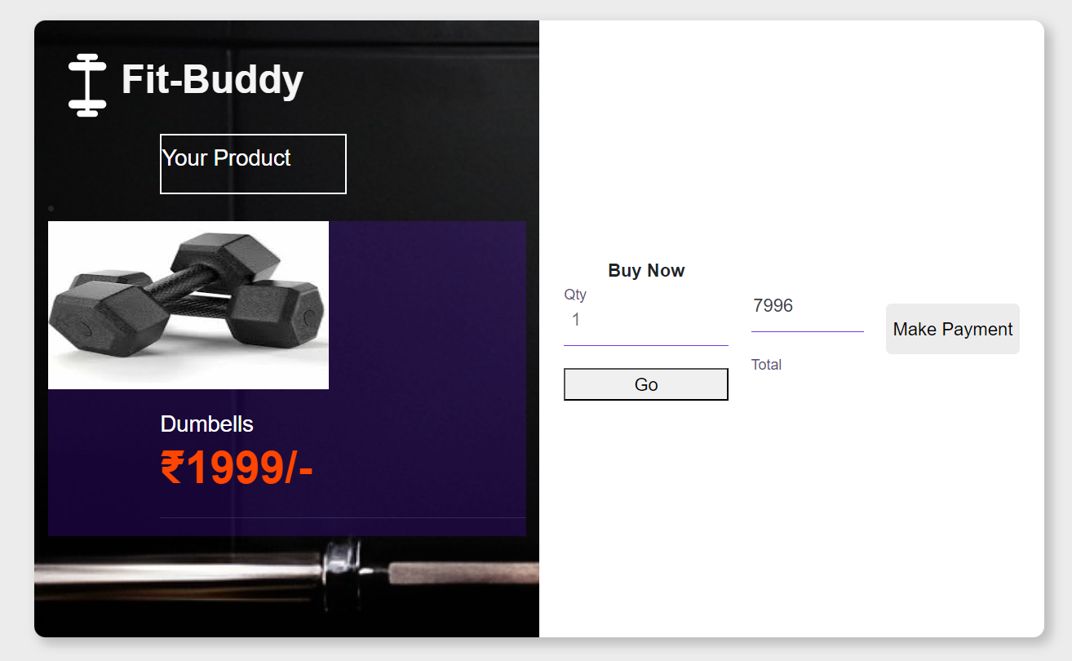
Product Buy Page

Slide 41
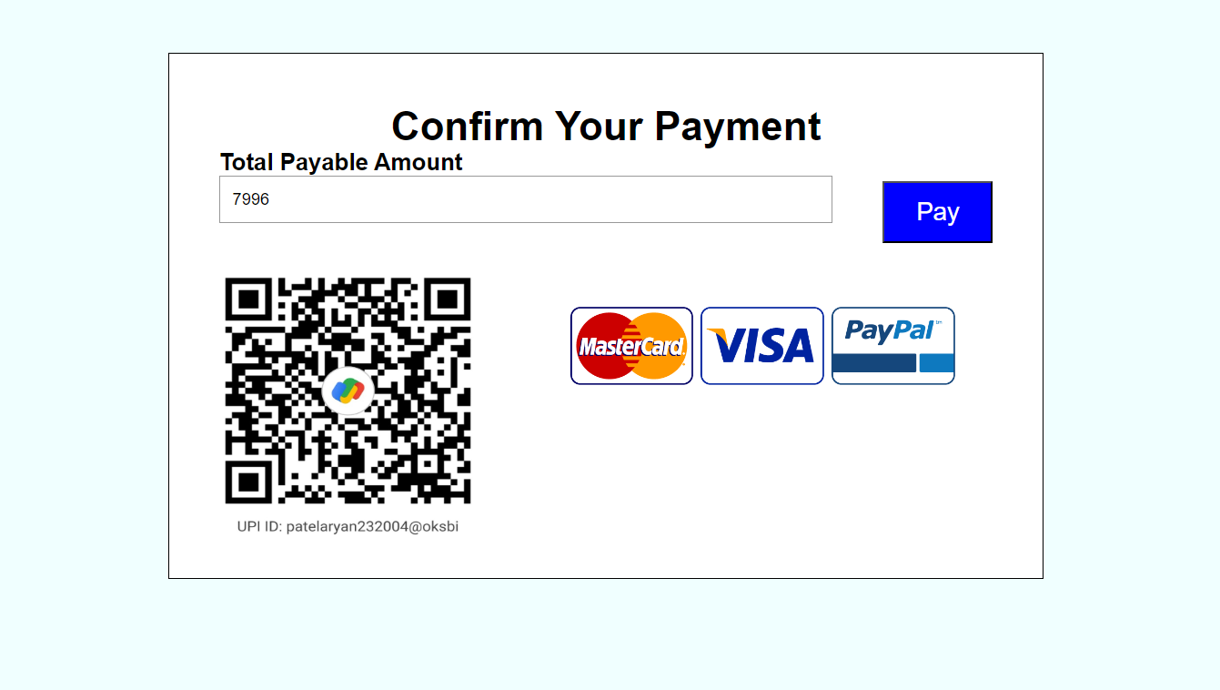
Payment Page Of Product

Slide 42
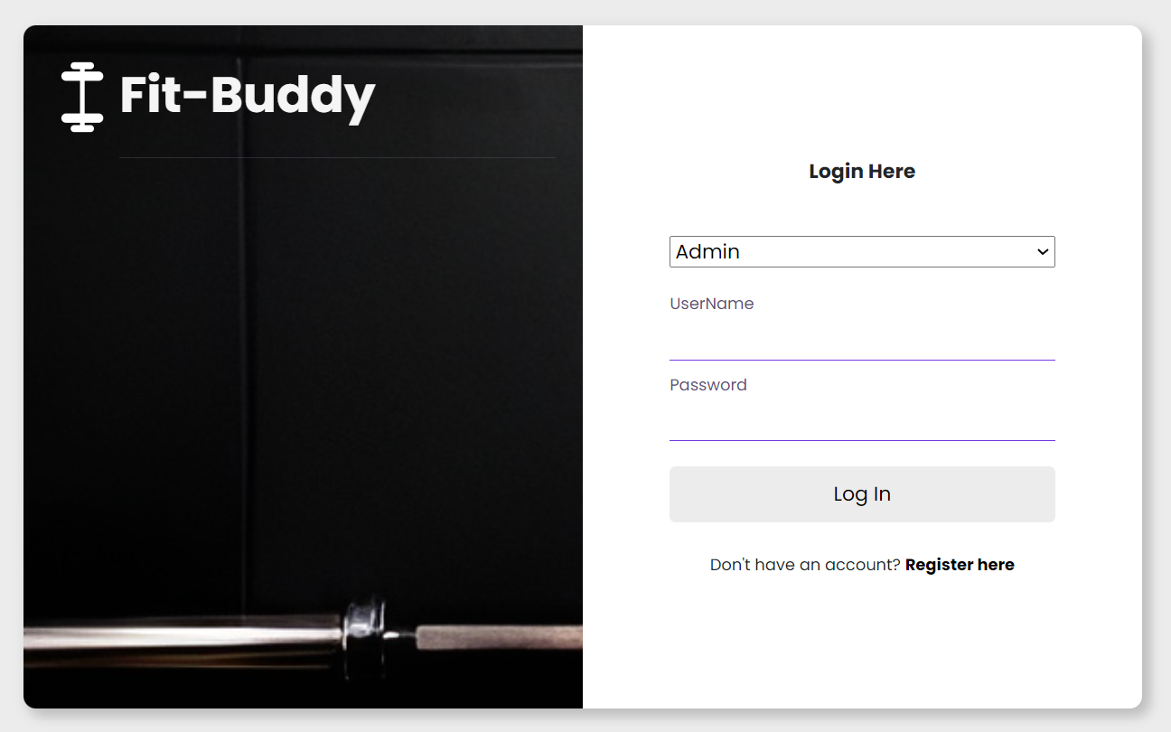
Screen Layout Admin Side
Login Page

Slide 43
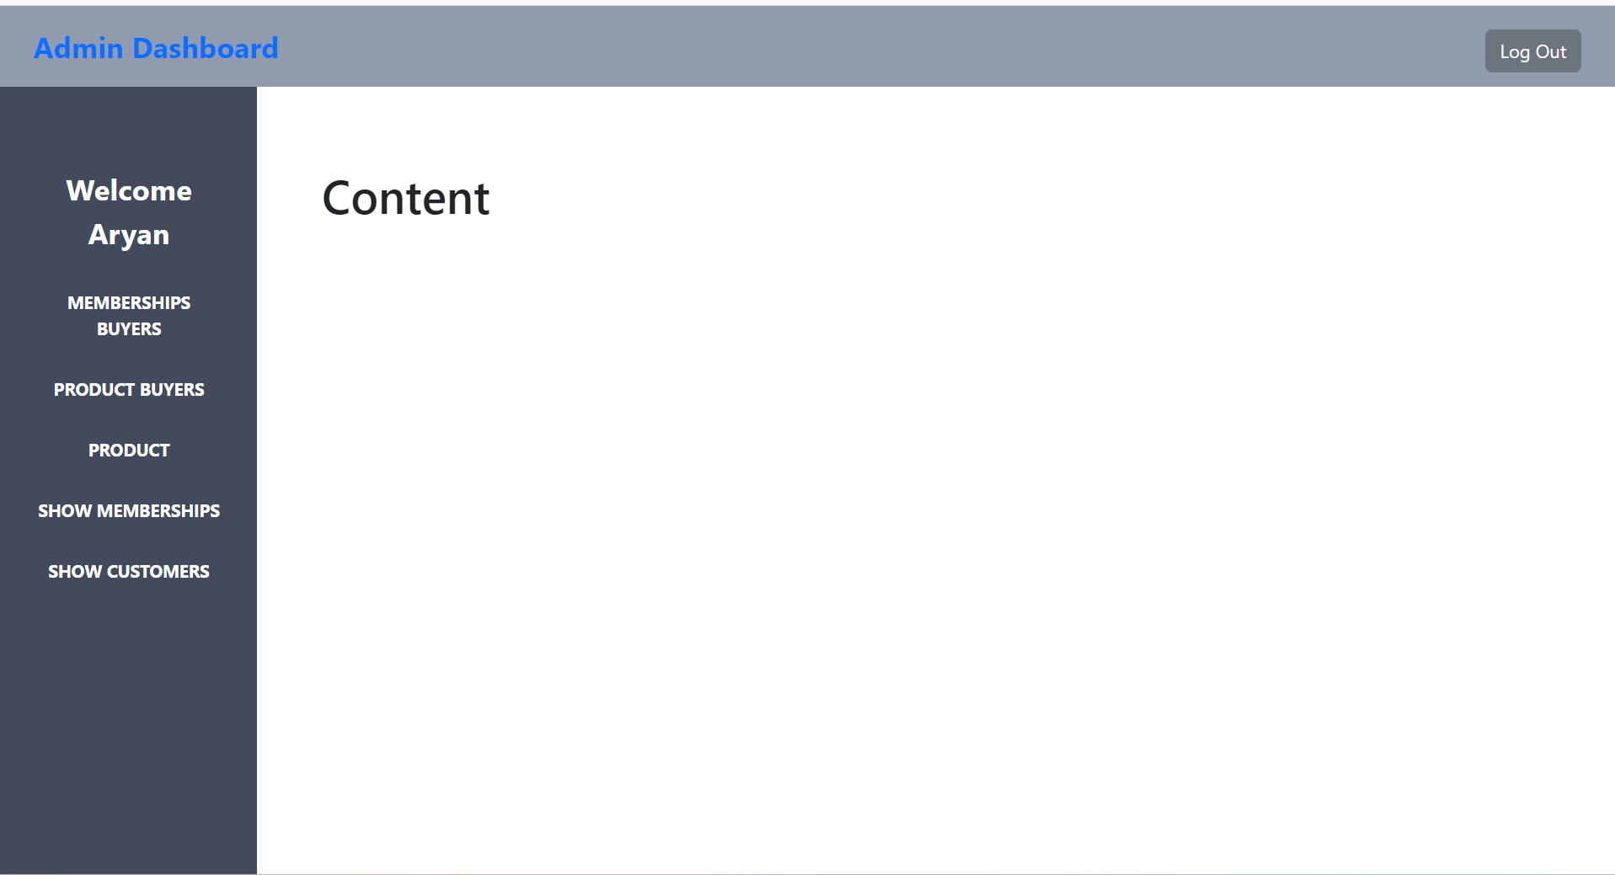
Admin Dashboard Page

Slide 44
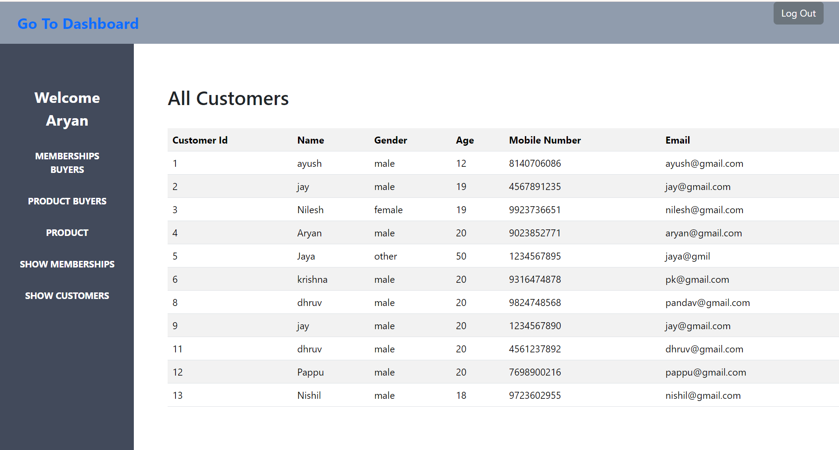
All Customers Page

Slide 45
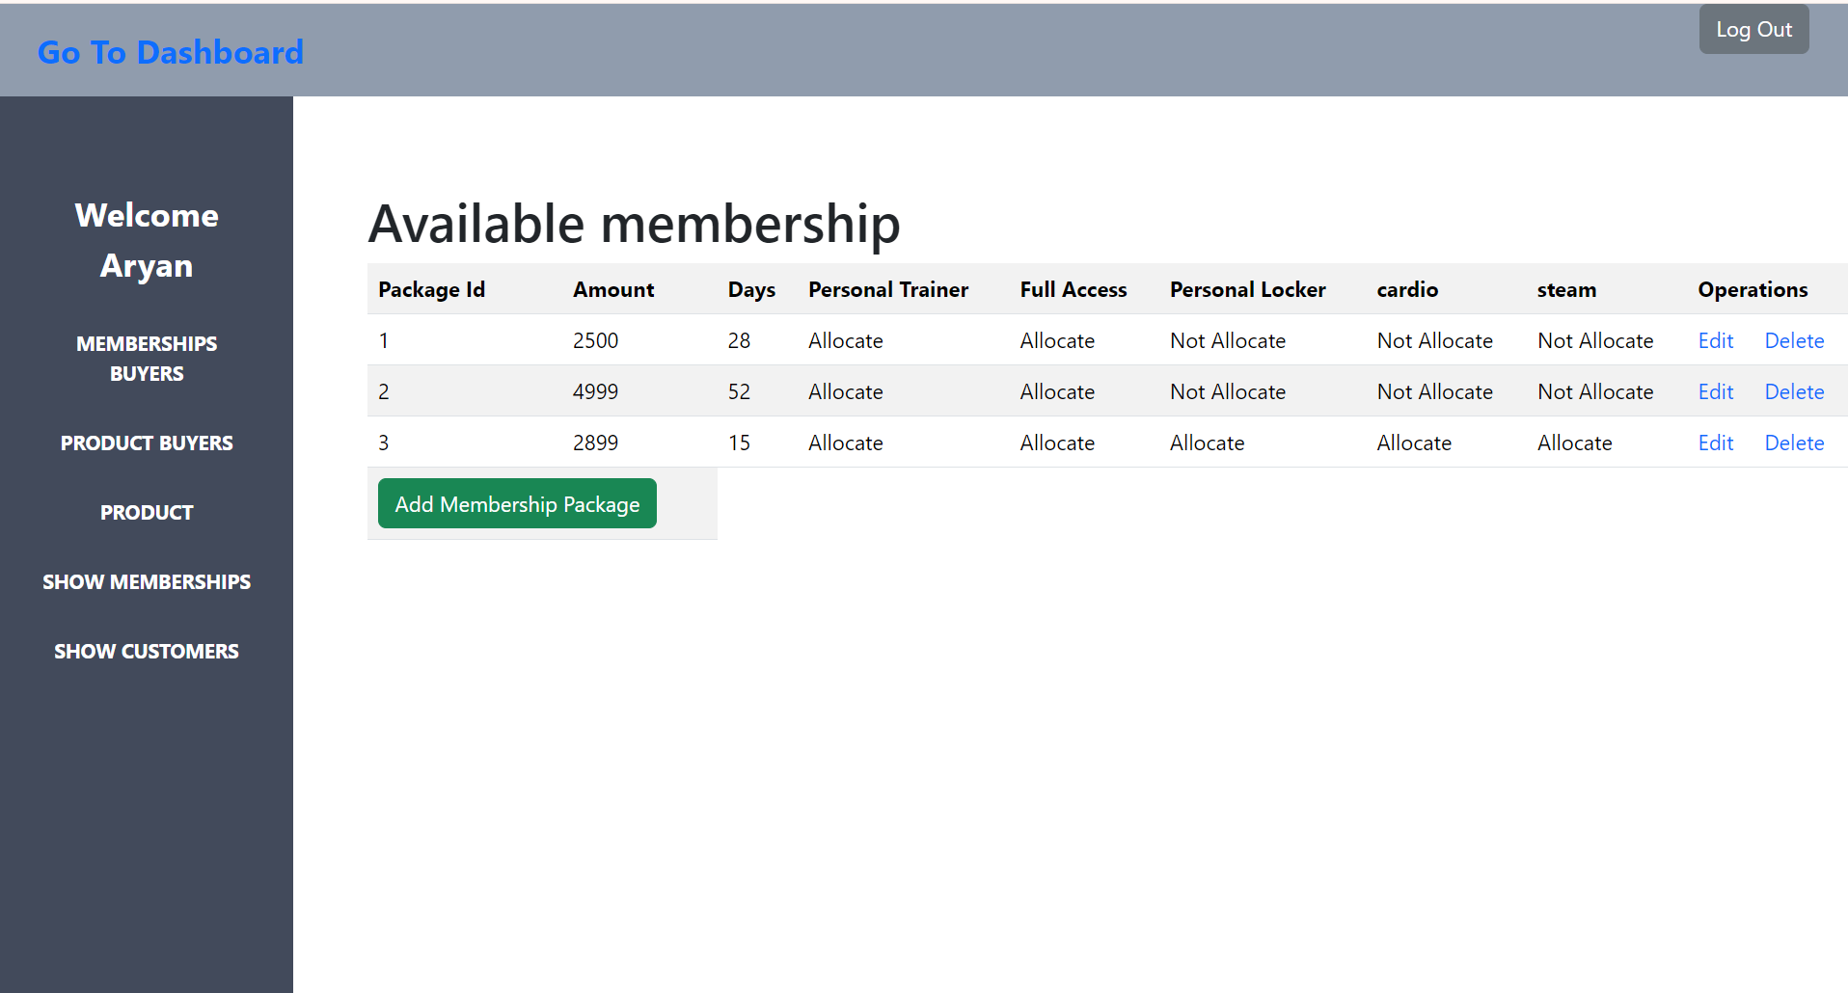
Memberships Page

Slide 46
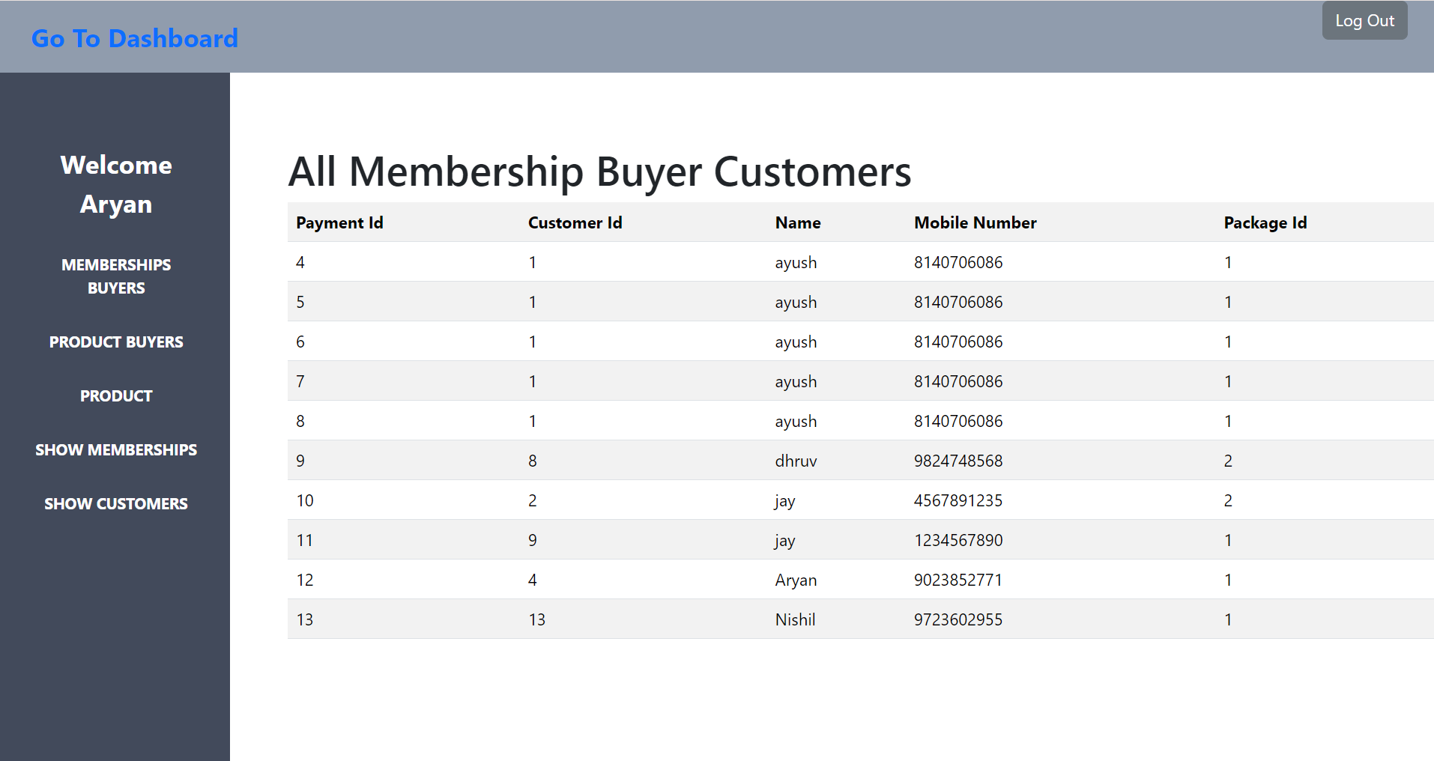
View Membership Buyer Page

Slide 47
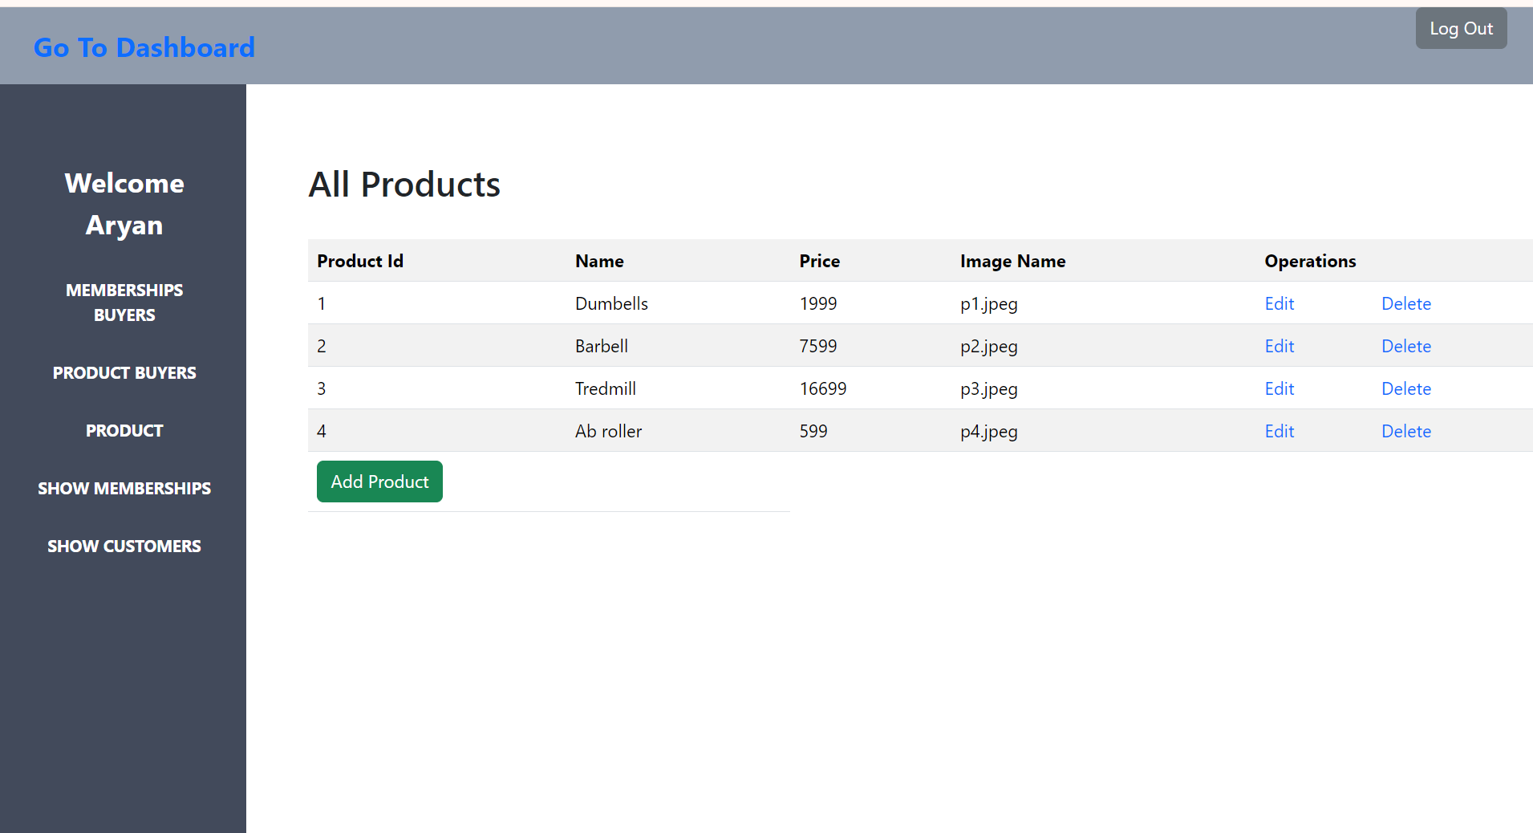
Products Page

Slide 48
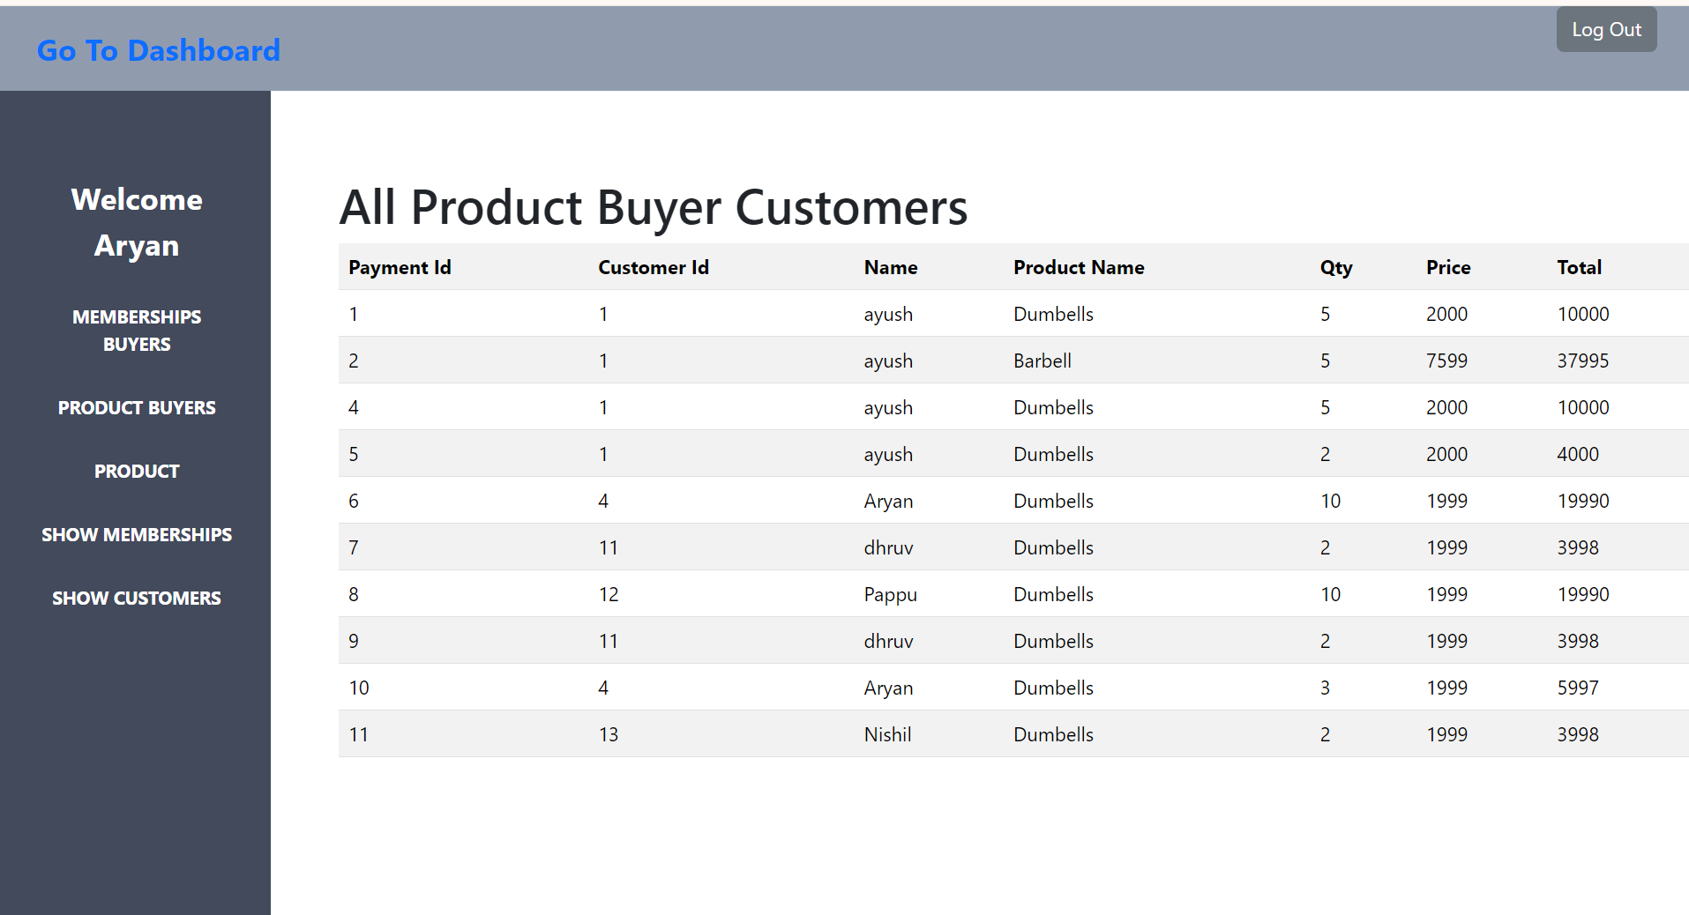
Product Buyers Page

Slide 49
Thank You For Your Valuable Time

